Slide 1
BT4016 Final Presentation
Group 10
Chew En Ren Janson (A0183927R)
Ho Ying Rong (A0188843M)
Koh Kai Jie Bryan (A0183858L)
Lim Jermaine (A0187866E)
Timothy Lim Shyen En (A0167597H)

Slide 2
Introduction
The investor profile
The target category
Benchmark Fund
Problem statement
Young, working adult
Long-term investment horizon
Aggressive investment attitude
Up to 20% of portfolio losses tolerated
Health and Biotech industry
Preference for growth stocks
Rapid capital appreciation
Higher risk
NASDAQ Biotechnology Index (^NBI)
NASDAQ-listed companies, classified as Biotechnology or Pharmaceuticals
Notes:
Definition for health and biotech: Specifically, health and biotech funds refer to those that invest in companies in the pharmaceutical, biotech and medical device industries

Slide 3
Best / Worst Portfolio
Compile Analyst Ratings
Analyse Historical Performance
Qualitative evaluation of fund
Lipper leader ratings for total returns and total consistent returns
Shortlist candidate funds as best / worst
Sharpe Ratio based on 2019 returns
Rank funds among the candidate best / worst
Profile of companies invested in
Analysts’ reports on company prospects

Slide 4
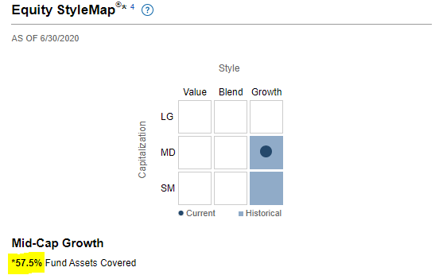
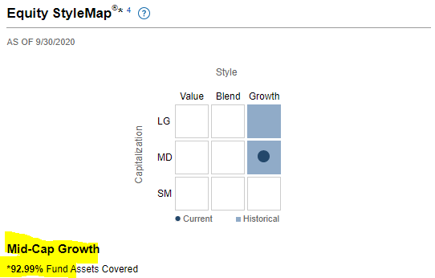
Best / Worst Portfolio
ETIHX (best)
2019 Sharpe Ratio: 2.21
RYCFX (worst)
2019 Sharpe Ratio: 1.17

Slide 5
Optimisation & Results

Slide 6
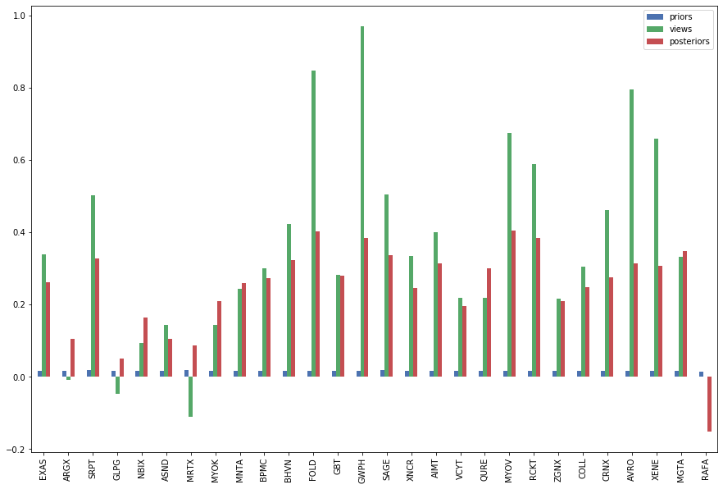
Optimisation
Adjustment of E(R)
Black-Litterman Model: blend market-implied returns with market outlook
Notes:
Views are quite aggressive, analysts have bullish outlook on market
Adjust this by assigning a lower confidence toward these views. We are not sure about the analysts’ track record or implicit biases etc.

Slide 7
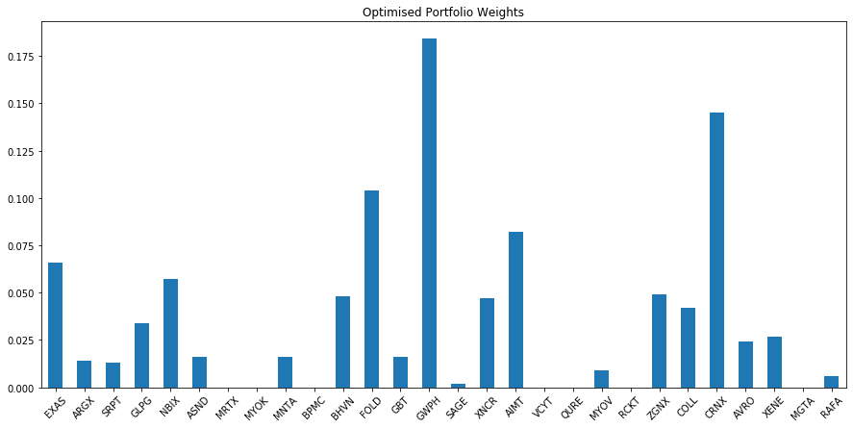
Optimisation
Optimise mean-variance utility function
Constraints based on minimum return, maximum risk and by market cap
Notes:
Results of optimisation in graph, can see that there are still some weights that are very high (eg. GWPH, CRNX). We reduce exposure to these assets as part of the subjective adjustment

Slide 8
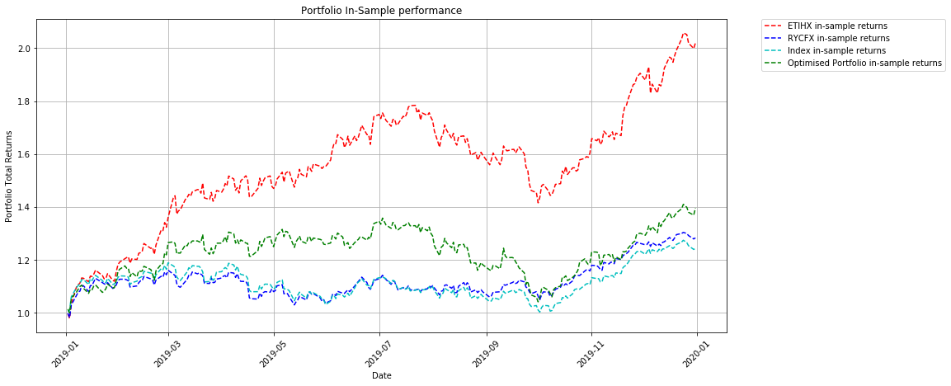
Portfolio Performance (2019)
Qualitative evaluation of fund
Portfolio | Ann. Return | Sharpe Ratio
ETIHX (best) | 0.99 | 3.46
RYCFX (worst) | 0.26 | 1.39
NBI (index) | 0.22 | 1.12
Optimised | 0.37 | 1.46

Slide 9
Portfolio Performance (2019)
Portfolio | 1-day 5% VaR* | 1-day 5% ES*
ETIHX (Best) | 2.7% | 3.8%
RYCFX (Worst) | 1.9% | 2.5%
NBI (Index) | 2.0% | 2.7%
Optimised | 2.5% | 3.4%
*values calculated using parametric approach

Slide 10
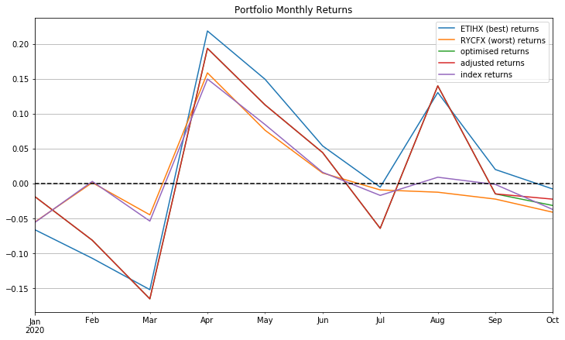
Portfolio Performance (2020)
Qualitative evaluation of fund
Portfolio | Total Return
ETIHX | 18.8%
RYCFX | 4.89%
Index | 8.22%
Optimised | 6.25%
Notes:
Similarity between RYCFX and index
Best and optimised portfolio are more similar

Slide 11
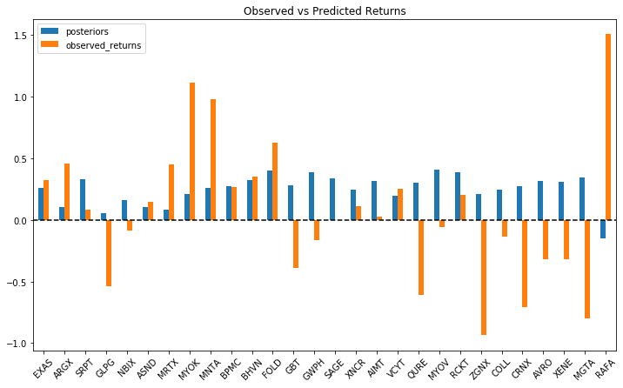
Portfolio Performance (2020)
Qualitative evaluation of fund
Notes:
Discrepancy between expected and observed returns

Slide 12
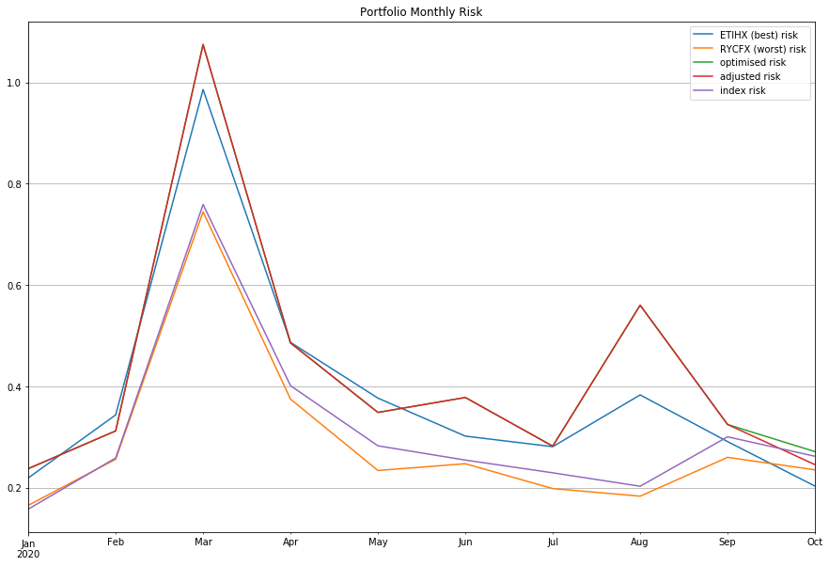
Portfolio Performance (2020)

Slide 13
Portfolio Performance (2020)
Portfolio | 1-day VaR (5% significance) | 1-day ES (5% significance)
ETIHX (best) | 3.29% | 6.64%
RYCFX (worst) | 2.87% | 4.87%
Index | 2.56% | 5.02%
Optimised | 3.86% | 7.17%

Slide 14
Hedging

Slide 15
Selection of Options
Choose suitable index
Choose option expiry
Choose strike price
Healthcare indexes: IXJ, IYH, FHLC
Market Index: GSPC
Select based on R^2
VaR analysis over 3/6/9 months
Calibrate E(R) and Var(R) using CAPM approach
Based on investment attitude and risk tolerance
Derive hypothetical price of index at level
Notes:
After which, trivial to calculate the number of contracts to purchase

Slide 16
Options Strategies
Protective Put
Covered Call
Collar Strategy
Problem statement
Limits downside risk
No upper bound on profits
Might be expensive
Generates income for purchase of assets
Upper bound on profits
Not applicable for risk management
Finance purchase of puts with premium collected from writing calls
Limits downside risk
Upper bound on profits
Notes:
Strategies considered when deciding how to protect our portfolio
Initial approach: bullish investment attitude, not willing to put limit on maximum profits
Select protective put strat

Slide 17
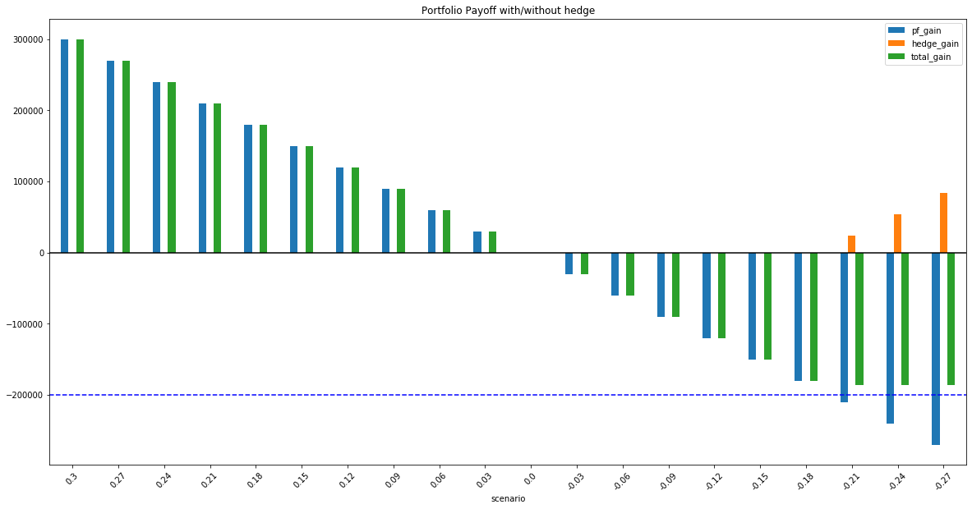
Payoff vs Profits
Hedge at 20% loss
Plot payoffs -> hedge works?
Qualitative evaluation of fund

Slide 18
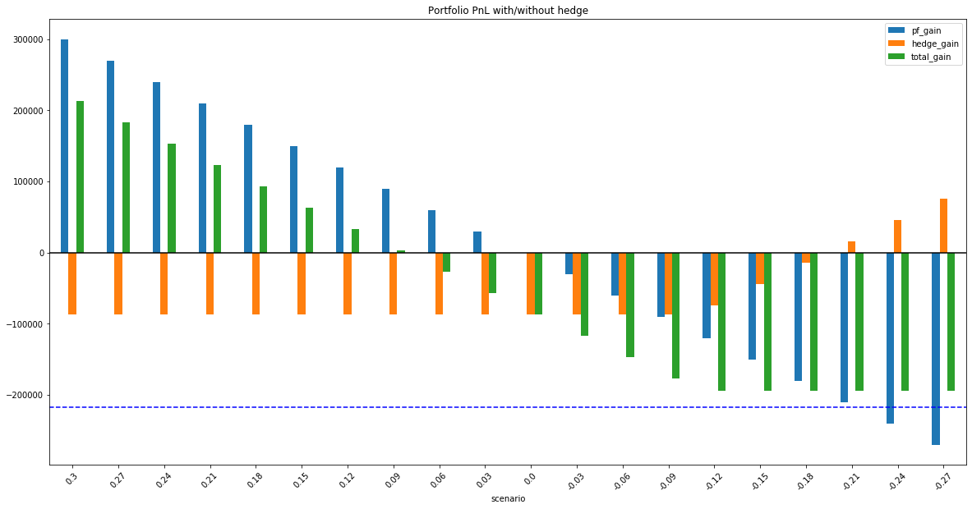
Payoff vs Profits
Hedge at 20% loss
Plot PnL -> hedge eats into profits
Qualitative evaluation of fund
Notes:
PnL is asymmetrical around 0
If options expire worthless, we will likely see a portfolio loss..or negligible returns
Also tried collar approach to finance the puts, but the bid-ask spread wide (0.15 vs 3.3)

Slide 19
Alpha Forecasting

Slide 20
Features
Closing Price
Daily Returns
Normalized Volume
Technical Indicators, including:
Exponential Moving Average (EMA) ー describes the average price of the asset over the past window with more weightage given to more recent observations
Moving Average Convergence Divergence (MACD) ー describes the relationship between the long term and short term relationship of the asset price
Market Momentum (MOM) ー describes the ‘ability’ of the market to sustain the current trend of the price movements
Dependent Variable: Monthly Alpha
Qualitative evaluation of fund

Slide 21
XGBoost
758 biotech stocks
Compute feature values
Aggregate to monthly
Combine
all stocks
FINAL DATASET
train-val-test split
training
validation
test
t-12 一 t-2
t-1
t

Slide 22
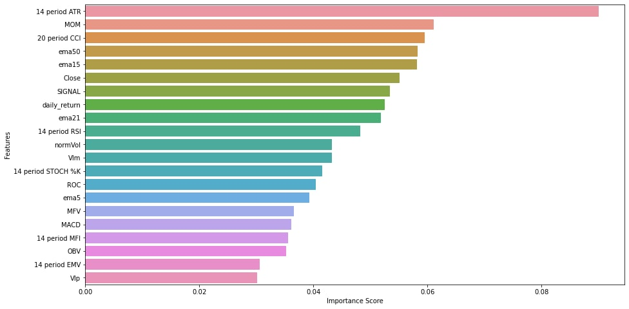
XGBoost
Notes:
Feature importance score by gain

Slide 23
Application to Portfolio Management
Estimate 1 year beta of the asset with the S&P 500 index
Estimate future returns of risky assets using predicted alpha and estimated beta → used as ‘views’ in BL model
Adjust confidence in BL model using model’s performance on the validation set
performance evaluated as proportion of predictions that the model was able to predict “correctly”
Repeat optimization process to get the new weights
Notes:
Point 1: 1 year used to estimate beta, might be unstable / not long enough time frame
Point 3: intuition is to get a gauge of the model’s ability to predict correctly. If it is able to predict the sign of alpha correctly, performance should translate reasonably well to regression predictions also

Slide 24
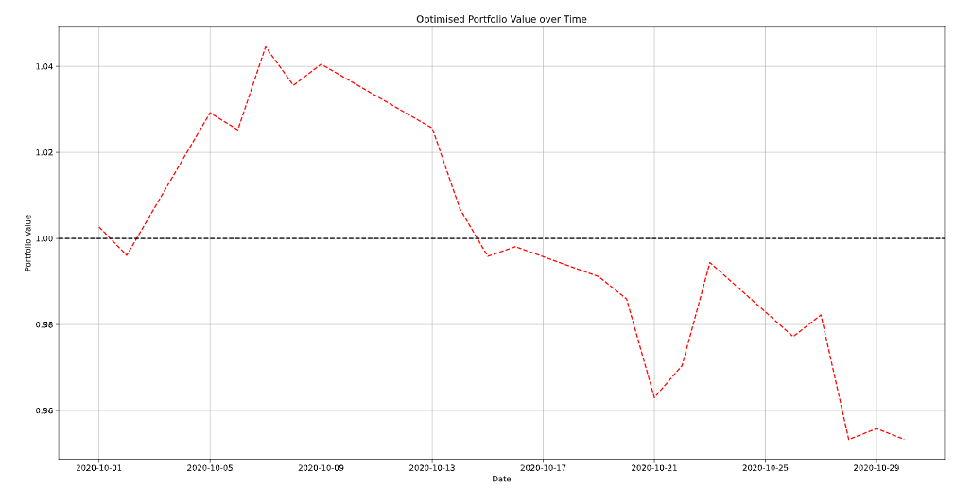
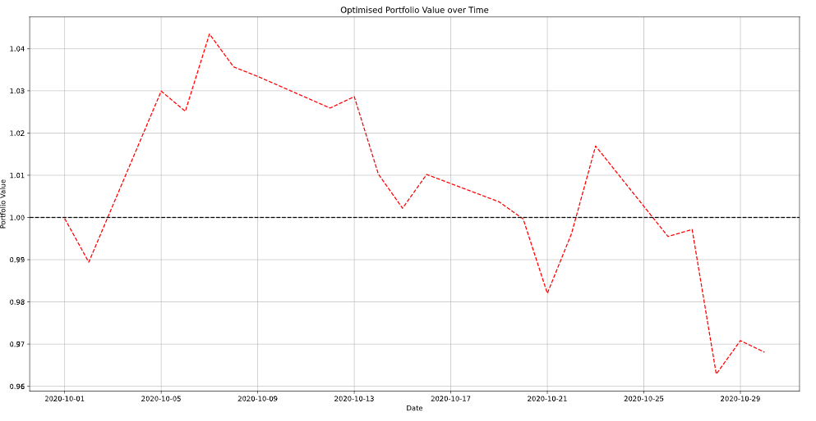
Results
XGBoost Views
Analyst Views
 | Return | Standard Deviation | Sharpe Ratio
Index | -3.54% | 2.62% | -1.35
Analyst Views | -3.12% | 2.47% | -1.26
XGBoost Views | -4.23% | 2.30% | -1.84

Slide 25
Future Improvements

Slide 26
Areas for Improvements
Assumed Factors affecting returns
Assumed returns of our assets follow CAPM
Choice of S&P 500 as market proxy may not be the best
Explore use of other index as market proxies
Selection of Instrument for Hedging
Limited choice of options
Large bid-ask spread
Explore use of other option contracts or financial instruments
XGBoost
Assumed that all biotech stocks exhibit similar behaviours
Try training different models for each stock
Perform more hyperparameter tuning

Slide 27
Thank you!

